Slide 1
Beyond atomistics: large scale atomistic fracture simulations in pyiron

Slide 2
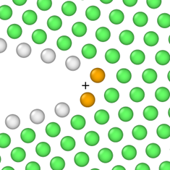
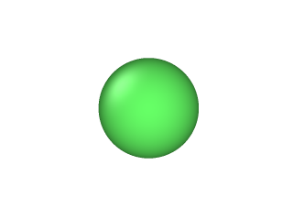
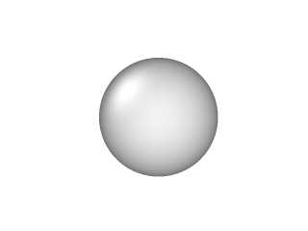
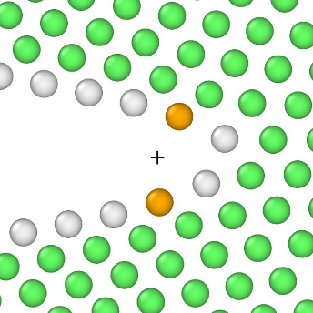
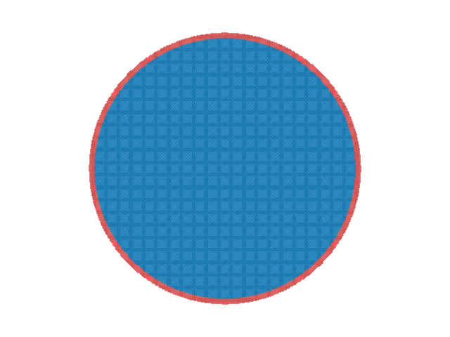
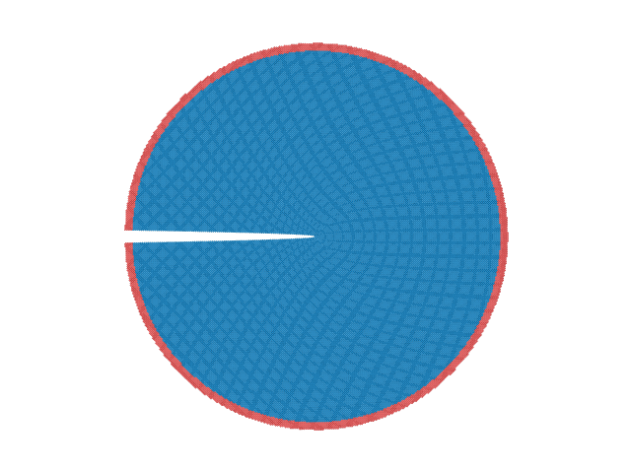
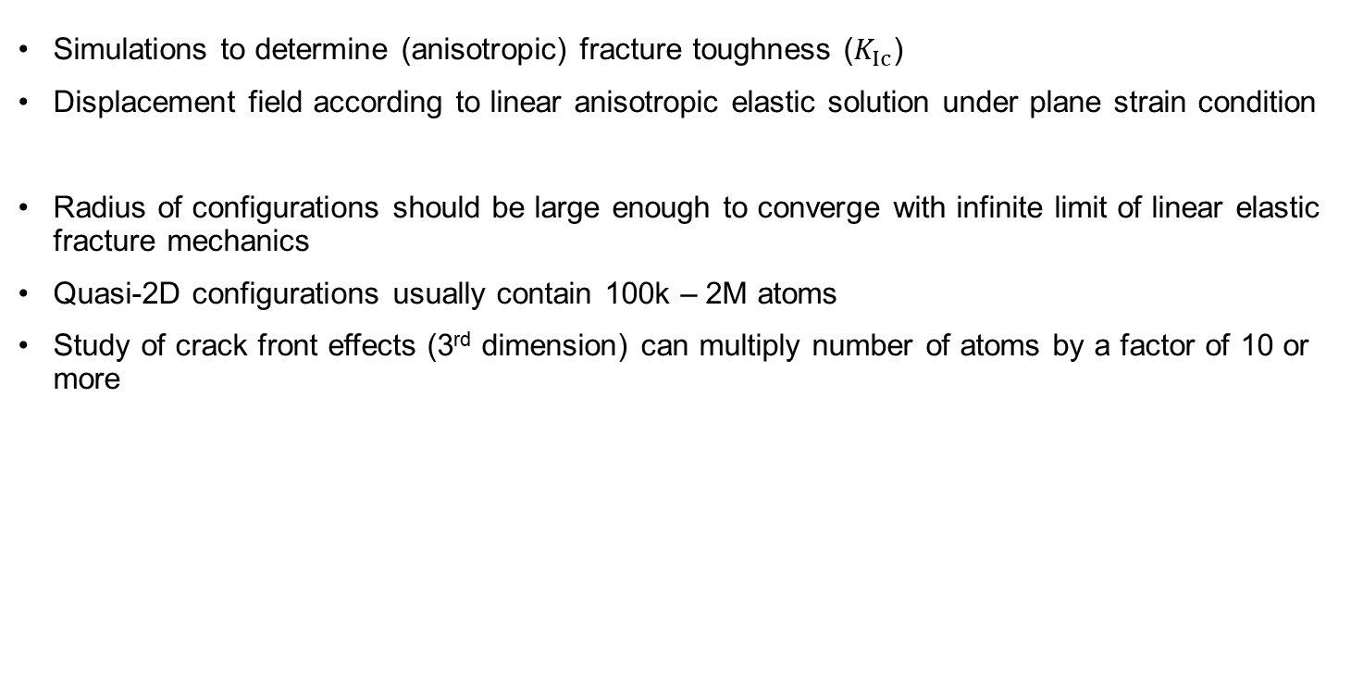
K-controlled “Pacman” crack configurations
Simulations to determine (anisotropic) fracture toughness ($K_{Ic}$)
Displacement field according to linear anisotropic elastic solution under plane strain condition
Radius of configurations should be large enough to converge with infinite limit of linear elastic fracture mechanics
Quasi-2D configurations usually contain 100k – 2M atoms
Study of crack front effects (3rd dimension) can multiply number of atoms by a factor of 10 or more
Adaptive CNA:
fcc
unidentified
(Normal to crack plane) Y
Atomically sharp crack
Disp. field
Boundary layers (red atoms) fixed
(Crack front dir.) Z
X (Propagation dir.)
Düsseldorf - pyiron hackathon 2024
Tara

Slide 3
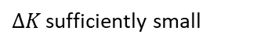

Loading procedure
Incremental (“quasistatic”) loading – minimization using FIRE
Typically 5 – 100 iterations for sharp cracks (average 50)
Möller and Bitzek, MSMSE, 2014
8 potentials (Fe)
6 crack systems
Approx. 2400 calculations
Hiremath et al., Comp. Mat. Sci., 2022
9 potentials (W)
9 crack systems
Approx. 4050 calculations
Wu and Curtin, Acta Mater., 2015
1 potential (Mg)
9 crack systems
3 small blunting radii
Approx. 1350 calculations
Atomically sharp crack
Identify load at which crack is stable at center: K_{in}
$ΔK$ sufficiently small
Crack propagates: $K_{Ic}^{∗}$
Düsseldorf - pyiron hackathon 2024
Tara

Slide 4

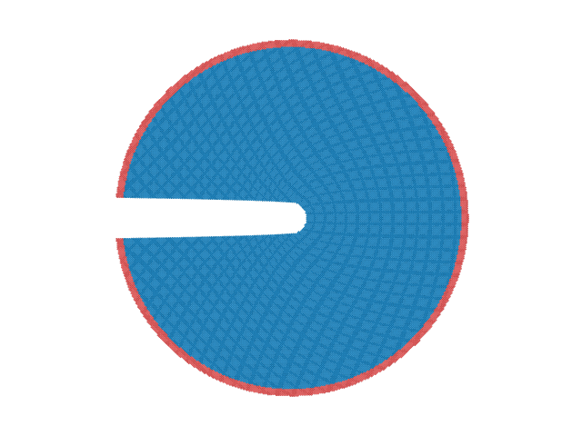
Influence of crack tip radius on fracture toughness of blunted cracks
Displacement field according to linear anisotropic elastic solution under plane strain condition
(Normal to crack plane) Y
Atomically sharp crack
Disp. field
Boundary layers (red atoms) fixed
(Crack front dir.) Z
X (Propagation dir.)
(Normal to crack plane) Y
Remove atoms
Disp. field
Blunted crack
(Crack front dir.) Z
X (Propagation dir.)
Düsseldorf - pyiron hackathon 2024
Tara

Slide 5

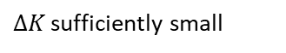

Loading procedure
Incremental (“quasistatic”) loading – minimization using FIRE
Blunting increases number of iterations to fracture
Atomically sharp crack
Blunted crack
Identify load at which crack is stable at center: K_{in}
Start at K_{in} identified for sharp crack
$ΔK$ sufficiently small
$ΔK$ sufficiently small
Crack propagates: $K_{Ic}^{∗}$
Sharp crack re-initiates: $K_{Ic}^{u}$
Düsseldorf - pyiron hackathon 2024
Tara

Slide 6
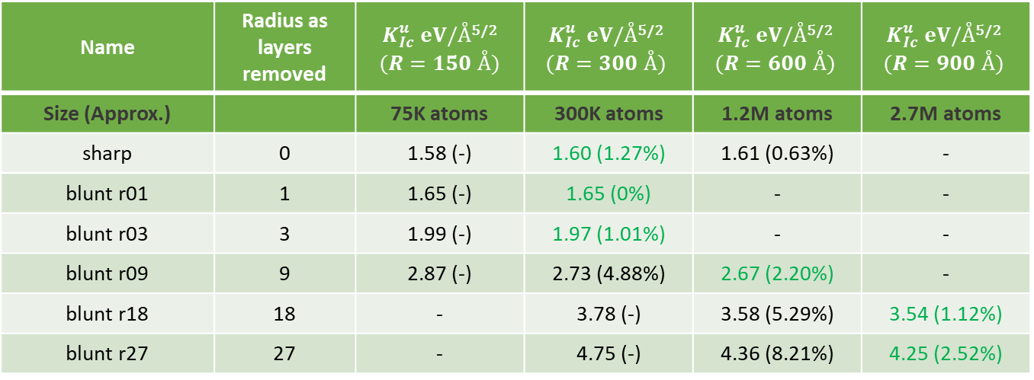
High-throughput nature
Blunting increases number of iterations to fracture
Large blunting increases necessary radius of configurations
2 crack systems, 2 harmonic potentials, average 200 iterations each: 6800 calculations
Name | Radius as layers removed | $K_{Ic}^{u} eV/Å$^{5/2} $(R=150 Å)$ | $K_{Ic}^{u} eV/Å$^{5/2} $$(R=300 Å)$$ | $K_{Ic}^{u} eV/Å$^{5/2} $$(R=600 Å)$$ | $K_{Ic}^{u} eV/Å$^{5/2} $$(R=900 Å)$$
Size (Approx.) |  | 75K atoms | 300K atoms | 1.2M atoms | 2.7M atoms
sharp | 0 | 1.58 (-) | 1.60 (1.27%) | 1.61 (0.63%) | -
blunt r01 | 1 | 1.65 (-) | 1.65 (0%) | - | -
blunt r03 | 3 | 1.99 (-) | 1.97 (1.01%) | - | -
blunt r09 | 9 | 2.87 (-) | 2.73 (4.88%) | 2.67 (2.20%) | -
blunt r18 | 18 | - | 3.78 (-) | 3.58 (5.29%) | 3.54 (1.12%)
blunt r27 | 27 | - | 4.75 (-) | 4.36 (8.21%) | 4.25 (2.52%)
Düsseldorf - pyiron hackathon 2024
Tara

Slide 7
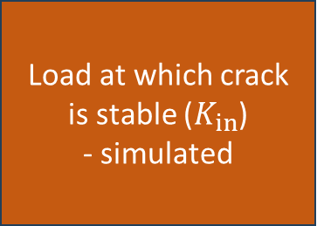
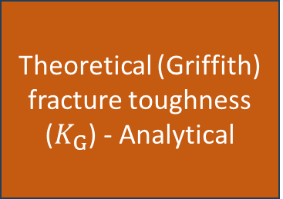
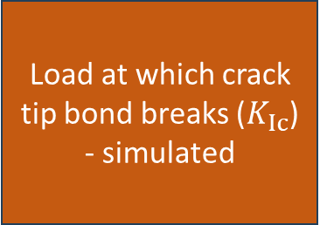
The Workflow: coarse-grained macro view
Surface energy
Elastic constants
Crystal parameters
Create cylinder without crack
Load at which crack tip bond breaks ($K_{Ic}$) - simulated
Theoretical (Griffith) fracture toughness ($K_{G}$) - Analytical
Load at which crack is stable ($K_{in}$) - simulated
Starting load for incremental loading
Initial guess for identifying load
Düsseldorf - pyiron hackathon 2024
Tara

Slide 8
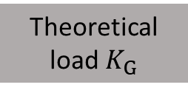
Theoretical fracture toughness: fine-grained node view
Surface energy
Rotate to orientation
Analytical calculation
Elastic constants
Theoretical load $K_{G}$
Orientation
Düsseldorf - pyiron hackathon 2024
Tara

Slide 9
Cylinder creator: fine-grained node view
Radius
Centre coordinates
Generic structure creator
Cut cylinder
Lattice constant
Cylindrical structure (no crack)
Orientation
Crystal structure type
Düsseldorf - pyiron hackathon 2024
Tara

Slide 10
Stable crack: fine-grained node view
Convergence criteria
Algorithm(s) choice
Boundary layer thickness
(Non-) Periodic boundaries
Cylindrical structure (no crack)
Displacement field (to introduce crack)
Energy Minimizer
Output structures
Orientation
Load
Elastic constants
for loop over load range
Düsseldorf - pyiron hackathon 2024
Tara

Slide 11
Incremental loading: fine-grained node view
Convergence criteria
Algorithm(s) choice
Boundary layer thickness
(Non-) Periodic boundaries
Stable crack structure
Only to start loading process
Displacement field (to increase load on crack)
Energy Minimizer
Orientation
Output structures
Load
Elastic constants
for loop over load range
Düsseldorf - pyiron hackathon 2024
Tara

Slide 12
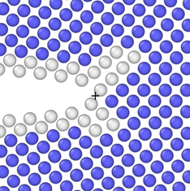
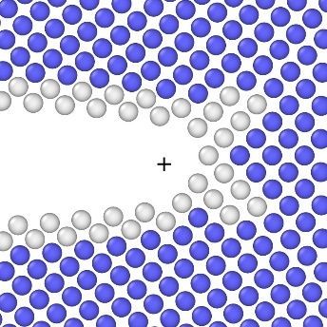
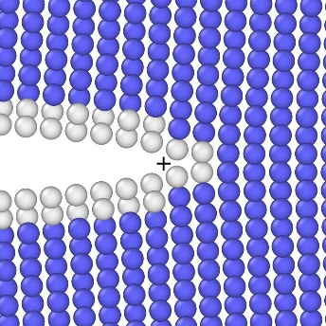
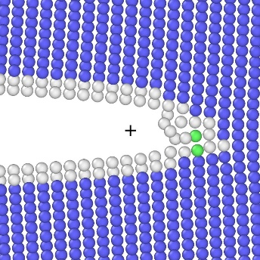
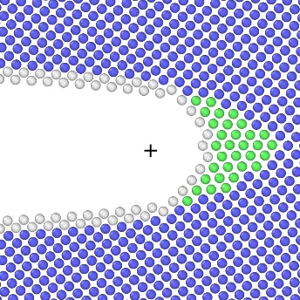
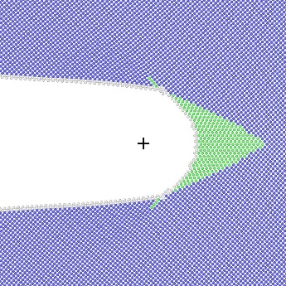
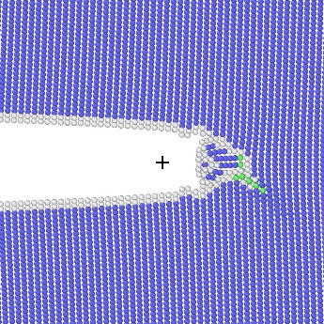
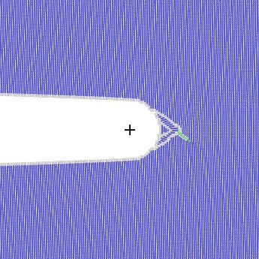
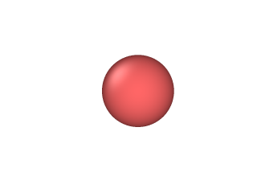
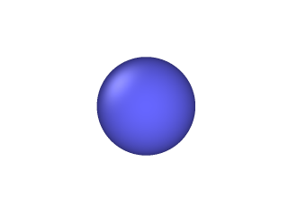
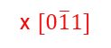
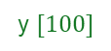
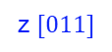
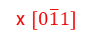
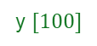
Visualization: Common Neighbour Analysis (CNA)
In many cases of studying qualitative fracture behaviour, the atoms of native crystal structure type can be hidden (e.g., Tungsten - bcc)
But those atoms may be important to study e.g., twins
Crack system (100)[001]
Crack system (100)[011]
sharp
blunt-r01
sharp
blunt-r01
blunt-r04
blunt-r16
blunt-r04
blunt-r16
y $[100]$
y $[100]$
z $[011]$
x $[0\overline{1}1]$
z $[011]$
x $[0\overline{1}1]$
Adaptive CNA:
fcc
hcp
bcc
unidentified
Düsseldorf - pyiron hackathon 2024
Tara

Slide 13
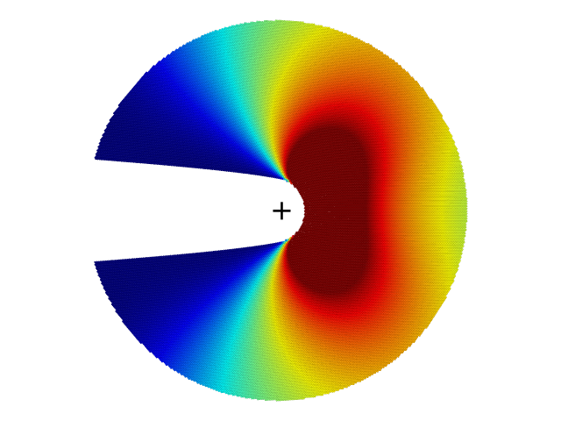
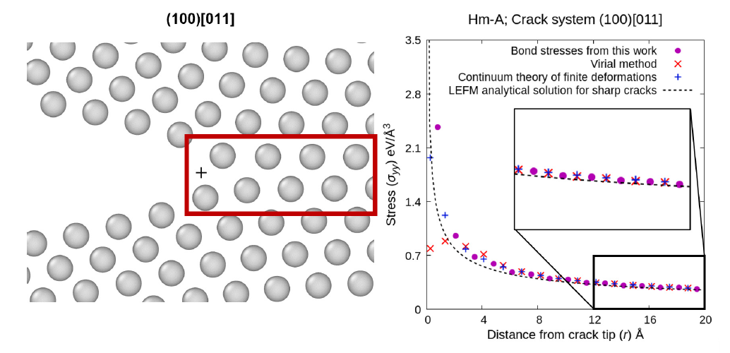

Visualization: Stress field analysis
Usually, the atomistic stresses are important only along the crack plane.
But even otherwise, the stresses only need to be visualized in a small-ish region close to the crack tip.
0
0.25
Atomic stress (σ_{yy}) eV/Å³
Düsseldorf - pyiron hackathon 2024
Tara

Slide 14
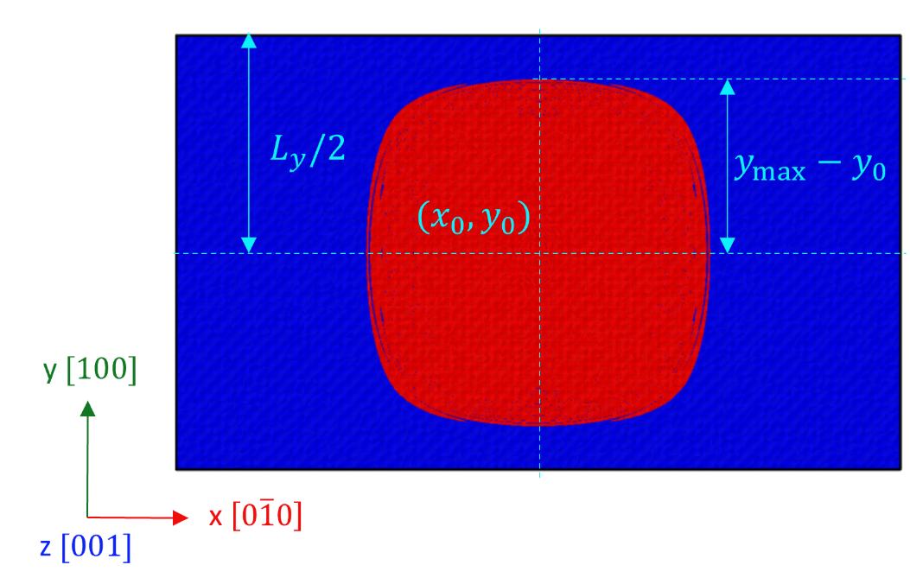
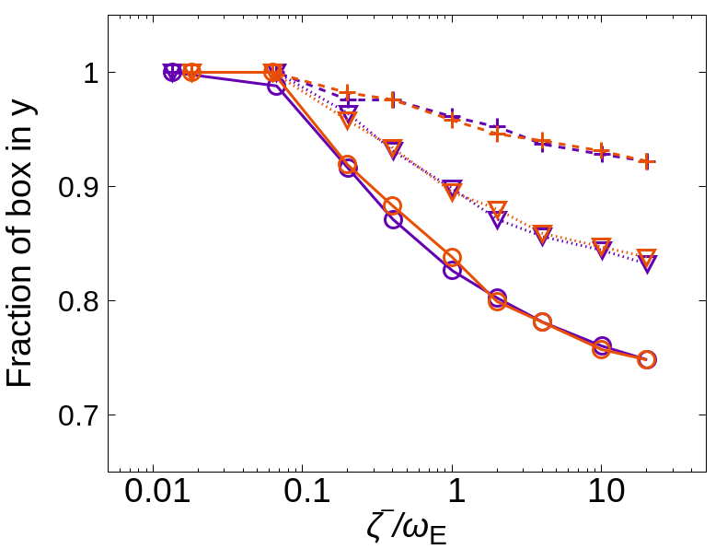
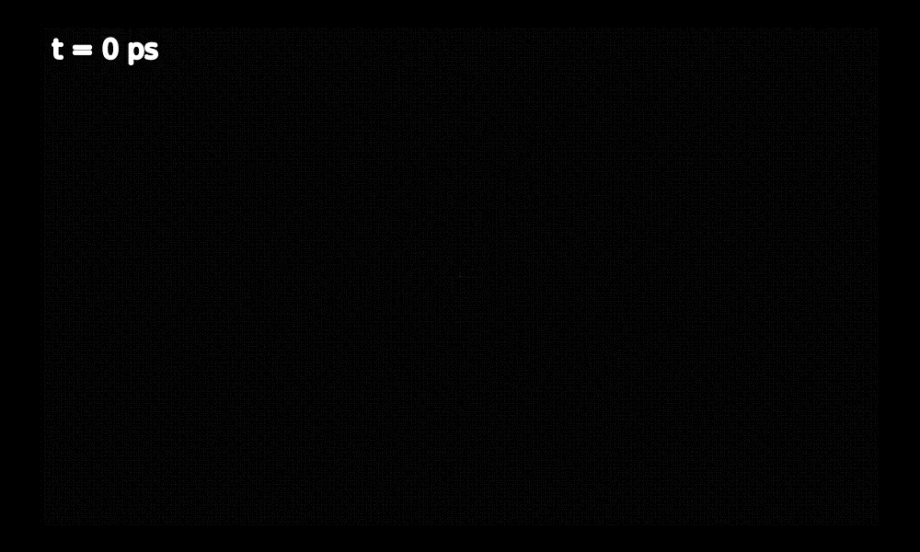
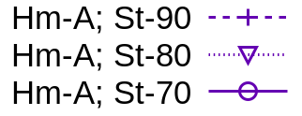
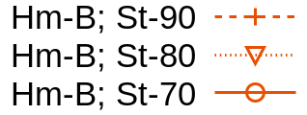

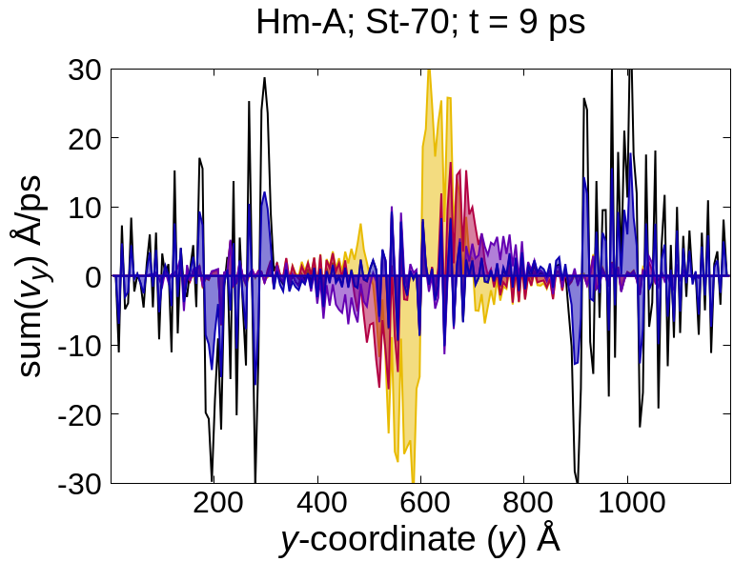
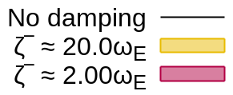
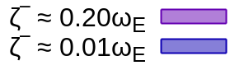
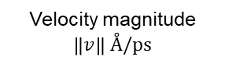
Another example of high-throughput large scale simulations: calibration of damping boundaries
2000 Å
Box edge
St-90
1200 Å
St-80
St-70
0
0.1
Velocity magnitude $\left\|v\right\| Å/ps$
Düsseldorf - pyiron hackathon 2024
Tara

Slide 15
Strategy
HPC jobs
Loading large configurations for post-processing, visualization
Visualization in notebook
FAIR
Düsseldorf - pyiron hackathon 2024
Tara

